Slide 1
Customer Data Analysis
(PRDA-05)
Batch Id: PTID-CDA-FEB-26-1285
Kaicharla Lalith Kumar
Bollam Sai Lavanya
Nagadurga Jahnavi
Mavuluri Rajendra Kumar

Slide 2

Business Problem Statement
Mostly organizations work with large datasets with raw data, which is not much helpful in decision making.
For effective decision making, we prefer to do structured analysis for obtaining meaningful insights.

Slide 3
Project Objectives
Shopping distribution according to gender
Sales based on gender
Distribution of purchase categories relative to gender and age group
Shopping distribution according to age
Sales among age category
Payment method relative to gender and category
Distribution of payment method
Derived insights and Business suggestions

Slide 4
Tools & Technologies
DATABASE
MySQL
QUERY LANGUAGE
SQL
VISUALIZATION
Power BI
DOCUMENTATION
MS Word & Power Point

Slide 5

Dataset Overview
This dataset contains shopping information from 10 different shopping
malls between 2021 and 2023. We have gathered data from various age
groups and genders to provide a comprehensive view of shopping habits
in Istanbul. The dataset includes essential information such as invoice
numbers, customer IDs, age, gender, payment methods, product
categories, quantity, price, order dates, and shopping mall locations.

Slide 6
1
COLLECT DATA
Methodology
2
CLEAN DATA
5 Key Steps to Analyze Data
Database connection using MySQL
Data cleaning and transforming using Power BI
Analyzing the data using MySQL
Dashboard creation using Power BI
Deriving meaningful insights and business recommendations
3
ANALYZE DATA
4
CREATE DASHBOARD
5
INSIGHTS & BUSINESS RECOMMENDATIONS

Slide 7
KEY PERFORMANCE INDICATORS (KPIs)
These KPIs provide a quick overview of business performance
Total Customers
Total Orders
Total Revenue
Average Order value
Total Quantity

Slide 8
Gender - Based Analysis
Shopping distribution by gender
Products sold to gender
Revenue generated by gender
Age Group
Analysis
Shopping distribution by age group
Products sold to age group
Revenue generated by age group

Slide 9
Payment method
& Time Trend Analysis
Distribution of payment method
Impact of payment methods by gender and category
Monthly Reveue Trends
Category Analysis
Distribution of purchase categories relative to gender and age group
Revenue generated by product category

Slide 10
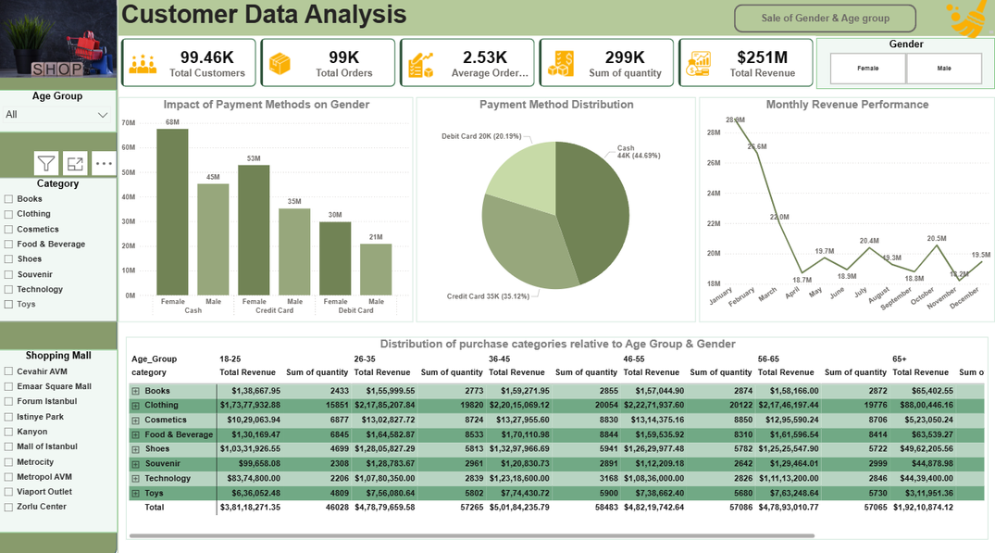
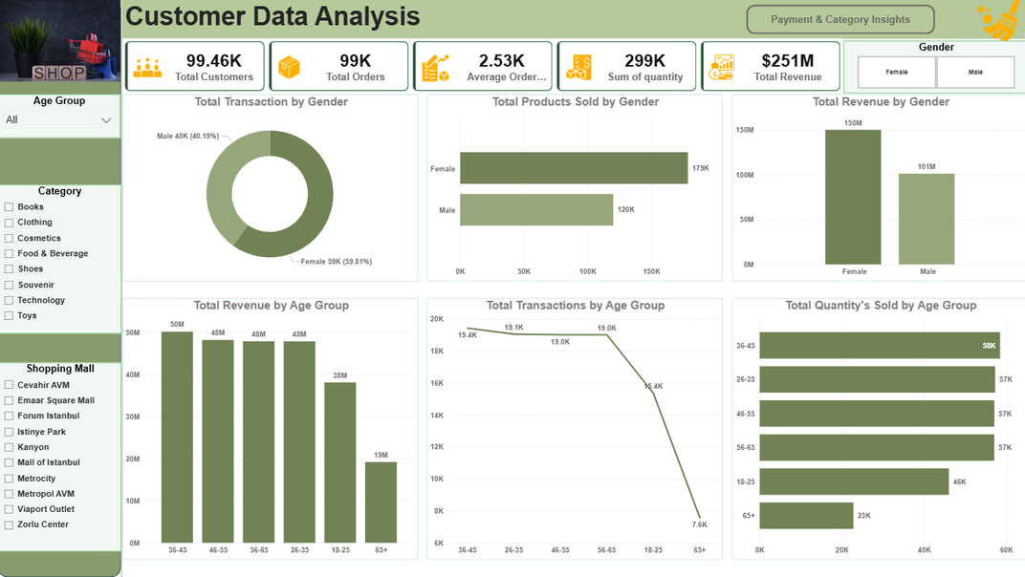
INSIGHTS
Female customers contribute high revenue
Age group 36-45 is the most valuable customer segment
Clothing and Shoes drive maximum sales
Cash is the most preferred payment method
Monthly revenue trends highlight January as the peak sales period.

Slide 11
Business Recommendations
Target Female customers using discounts and promotions.
Age group 36-45 should be given priority in order to increase sales
Introduce bundled offers in Clothing category
Encourage loyal customers by giving offers
Introduce marketing strategies in the end of the year
Improve cash billing speed for smooth checkouts.

Slide 12
Thankyou

